Slide 1
Office 365 List Formatting
And 2019 too!
(sorta)
Chris Kent
Office 365 Practice Lead, DMI

Slide 3















“Me”
Indianapolis, IN
Office Development
Office 365 Practice Lead
@theChrisKent
Member of the Core Team
theChrisKent.com
Notes:
Can I possibly get my name on a single slide even more? Wow.

Slide 4













Platinum Sponsors
Silver Sponsors
Speaker Dinner Sponsor
To all of our sponsors,
Thank you!
Gold Sponsors

Slide 5
Goals

Slide 6
Column Formatting
What | Why | How

Slide 7
View (Row) Formatting
What | Why | How

Slide 8
PnP List Formatter
Setup | FormatScript | Tips

Slide 9
Patterns & Practices
Samples | Guidance

Slide 11

Declarative modern listview customization
O365 List Formatting

Slide 12

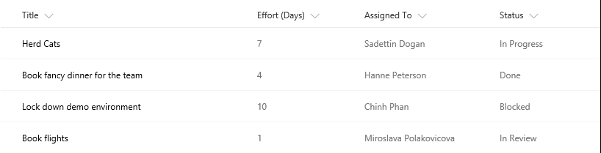
The Modern Listview
Responsive
Fancy
Boring
No XSLT
No Calculated Column Trickery

Slide 13


Dapper
The Modern Listview

Slide 14

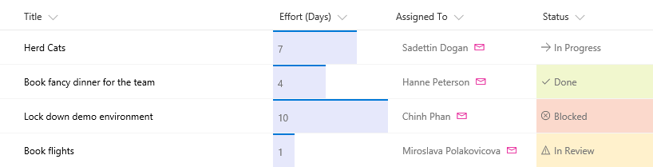

Slide 15
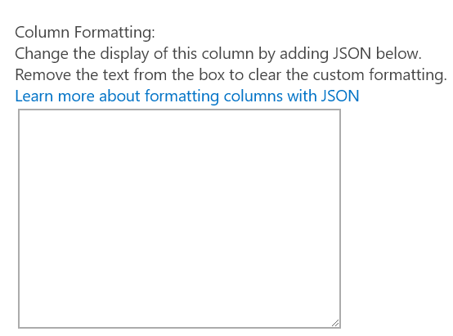
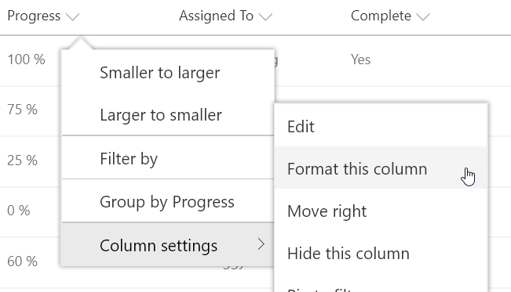
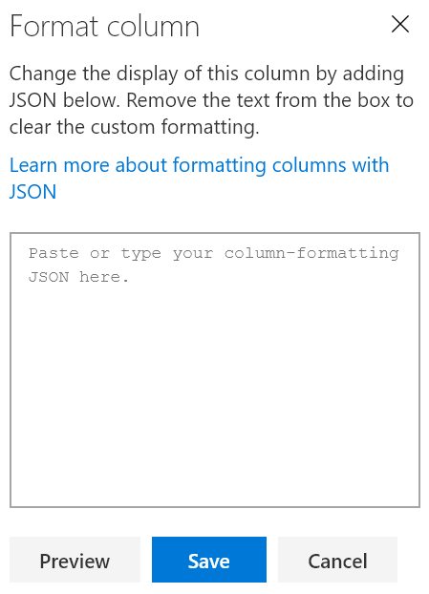

Column Formatting
JavaScript Object Notation (JSON)
Apply directly to list fields or site columns
Field Settings
Format this column menu
Stored with the Field
Paste Here
O365 & 2019

Slide 16
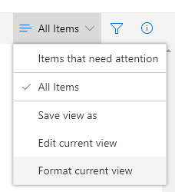

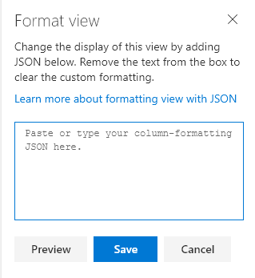

View Formatting
Not Yet Released!
Superset of Column Formatting
Apply directly to views
Format current view menu
Stored with the View
Overrides Column Formats
Paste Here
O365 & 2019

Slide 17

Demo: Applying OOTB
List Formatting
Notes:
gulp bundle --ship
gulp package-solution --ship
Navigate to package
sharepoint > solution
Drag package on to Apps for SharePoint in App Catalog
Check the box for tenant wide deployment
Deploy
Add to a page
Update the solution
Add the border color to the specialBox
gulp bundle --ship
gulp package-solution --ship
Navigate to package
sharepoint > solution
Drag package on to Apps for SharePoint in App Catalog
Replace
Check In

Slide 18
Basic JSON Format (Totally NOT custom code)
Elements – elmType
div, span, a, img, svg, path, button
Content - txtContent
Attributes - attributes
class, href, src, rel, target, title, role, d, aria, iconName
Style – style (124 properties)
Children – children
Operators & Operands
basic math, comparison, conversion, logical

Slide 19


Supported Column Types
Single line of text
Number
Choice
Person or Group
Yes/No
Hyperlink
Picture
Date/Time
Lookup
Title (in Lists)
Same support across both Column and View Formatting
Can’t Reference:
Managed Metadata
Calculated
Retention Label
Filename (in Document Libraries)
https://github.com/SharePoint/sp-dev-docs/issues/1524

Slide 20
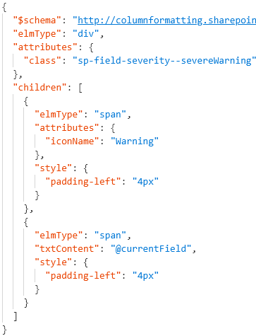

Format JSON
Rendered Column
Element Visualization
div
span
span
Generated HTML
<div class="sp-field-customFormatter sp-field-severity--severeWarning">
<span style="padding-left:4px;" iconname="Warning" class=" css-148"></span>
<span style="padding-left:4px;">Wise Polar Bear</span>
</div>

Slide 21

View Formatting Syntax
Top level props
hideColumnHeader
When true, the view won’t have any column headers
hideSelection
When true, users can’t select rows
additionalRowClass
Class(es) to apply to the whole row
You can use operation syntax
Only applied when rowFormatter is not specified
rowFormatter
Column Formatting syntax to create elements

Slide 22
Magic Text
…
“txtContent”: “@currentField”
…
“@currentField”
Get the current item’s value
Works great for simple values (text, choice, yes/no, and numbers)
Type is respected
Dates should use one of the format operations:
“toLocaleString()” – date and time
“toLocaleDateString()” – just the date
“toLocaleTimeString()” – just the time
Always resolves to Title in view formatting

Slide 23
Magic Text
…
“txtContent”: “@currentField.title”
…
“@currentField”
Get the current item’s value
Person field props
Can’t use “@currentField” directly, use dot-notation to get properties:
“@currentField.title”
“@currentField.id”
“@currentField.email”
“@currentField.sip”
“@currentField.picture”

Slide 24
Magic Text
…
“txtContent”:
“@currentField.lookupValue”
…
“@currentField”
Get the current item’s value
Person field props
Can’t use @currentField directly, use dot-notation to get properties:
“@currentField.lookupValue”
“@currentField.lookupId”
Lookup field props

Slide 25
Magic Text
…
“txtContent”:
“@currentField.desc”
…
“@currentField”
Get the current item’s value
Person field props
Can use @currentField directly AND dot-notation to get properties:
“@currentField” – URL value
“@currentField.desc” - Description
Lookup field props
Hyperlink field props

Slide 26
Magic Text
…
“txtContent”: “[$Title]”
…
“@currentField”
Get the current item’s value
Person field props
Wrap internal name in [$FIELD]
Access Person/Lookup/URL properties in same way as with @currentField
“[$Author.email]”
“[$OtherListItem.lookupValue]”
Lookup field props
Hyperlink field props
Other Fields (same row)

Slide 27
Magic Text
…
“txtContent”: “@me”
…
“@currentField”
Get the current item’s value
Person field props
“@me” resolves to the current user’s email address
“@now” resolves to the date/time at render (doesn’t keep getting evaluated)
Lookup field props
Hyperlink field props
Other Fields (same row)
“@me”
“@now”

Slide 28
Magic Text
…
“txtContent”:
“@window.innerHeight”
…
“@currentField”
Get the current item’s value
Person field props
“@window.innerHeight” resolves to a number equal to the height of the browser window (in pixels) at render
“@window.innerWidth” resolves to a number equal to the width of the browser window (in pixels) at render
Lookup field props
Hyperlink field props
Other Fields (same row)
“@me”
“@now”
These do NOT update as the window resizes
“@window”

Slide 29
Column Formatting vs Field Customizer
Customization | Column Formatting | Field Customizer
Conditional Formatting based on item values | Supported | Supported

Slide 30
Column Formatting vs Field Customizer
Customization | Column Formatting | Field Customizer
Conditional Formatting based on item values | Supported | Supported
Action Links | Static links (no script) | Any type of link

Slide 31
Column Formatting vs Field Customizer
Customization | Column Formatting | Field Customizer
Conditional Formatting based on item values | Supported | Supported
Action Links | Static links (no script) | Any type of link
Visualizations | Simple Visualizations (HTML & Styles) | Whatever!

Slide 32
Column Formatting vs Field Customizer
Customization | Column Formatting | Field Customizer
Conditional Formatting based on item values | Supported | Supported
Action Links | Static links (no script) | Any type of link
Visualizations | Simple Visualizations (HTML & Styles) | Whatever!
Page Context | @now, @me, window size | Full context!

Slide 33
Column Formatting vs Field Customizer
Customization | Column Formatting | Field Customizer
Conditional Formatting based on item values | Supported | Supported
Action Links | Static links (no script) | Any type of link
Visualizations | Simple Visualizations (HTML & Styles) | Whatever!
Page Context | @now, @me, window size | Full context!
JS Libraries | Nope | Go for it!
Custom CSS Classes | Nope, limited subset & inline styles | Go for it!
Interactivity | Nope | Go for it!

Slide 34

Column Formatting vs Field Customizer
Customization | Column Formatting | Field Customizer
Conditional Formatting based on item values | Supported | Supported
Action Links | Static links (no script) | Any type of link
Visualizations | Simple Visualizations (HTML & Styles) | Whatever!
Page Context | @now, @me, window size | Full context!
JS Libraries | Nope | Go for it!
Custom CSS Classes | Nope, limited subset & inline styles | Go for it!
Interactivity | Nope | Go for it!
Developer Required | “No” | Yes
Solution Deployment | Nope! | Required
Use Column Formatting when possible, but know it’s limits

Slide 35

List Formatting Limitations
No String Operations
No Custom Date Formats or Date Parts
No viewbox attribute for SVG elements
Unable to use parenthesis in style props (except for rgba)
No Gradients
No image backgrounds
Absolute links only
No access to key URLs like AbsoluteUrl or ServerRelativeUrl
Numbers are floats and you can’t round them
Unable to determine Row Index
Rows are always stacked
OOTB User Interface is terrible

Slide 36

List Formatting Awesomeness
Quick & “easy” visualizations that can have a significant impact
Site Column integration provides centralized configuration
Text based config (easy source control)
NO Solution Package deployment required
Can be applied by Site Designers
Supported in Site Designs
PnP List Formatter fills the UI gap

Slide 37
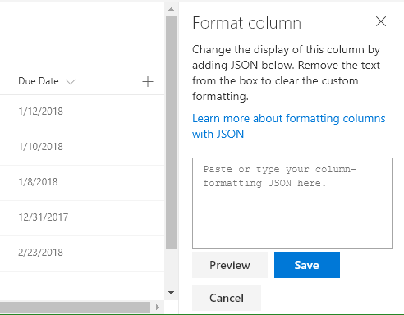
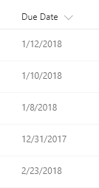

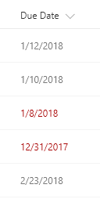



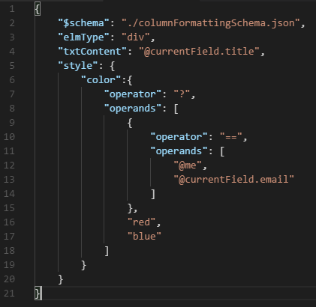

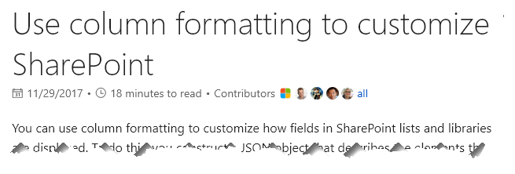




Slide 38
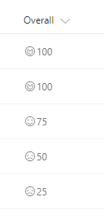
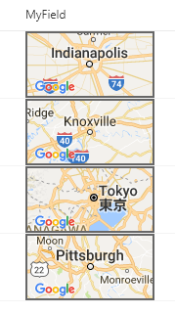
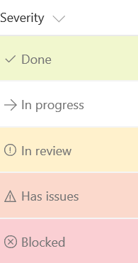

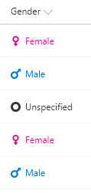
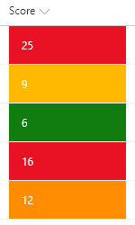

SP-Dev-List-Formatting Samples
25+ Sample Formats
Instructions & Screenshots
Copy & Paste directly from Github
github.com/SharePoint/SP-Dev-List-Formatting

Slide 39



List Formatter Easy editor for modern listview Formatting
github.com/SharePoint/SP-Dev-Solutions

Slide 40
Final Tips & Tricks
Dapper
The Modern Listview
UI Fabric Classes
Theme Colors
Hover Styles
Grid System
Turn debugMode off
Write HTML 1st
Dynamic Images
1000+ icons – use them!
Use List Formatter

Slide 41

aka.ms/sppnp

Slide 42


Slide 43


Bi-Weekly
SP General Development
aka.ms/sppnp-core-sig-call
PowerShell, Provisioning, CSOM
Next Call: Thursday, 8/9
Bi-Weekly
SharePoint Framework
aka.ms/sppnp-js-sig-call
SPFx, PnP JS Core
Next Call: Thursday, 8/2
Monthly
Community Calls
aka.ms/sppnp-call
Monthly Summary
Next Call: Tuesday, 8/13

Slide 44



Official Blog
dev.office.com/blogs
Twitter
@OfficeDevPnP
Tech Community
aka.ms/sppnp-community

Slide 45

SharePint
Happy Hour after SPCLT

Slide 46
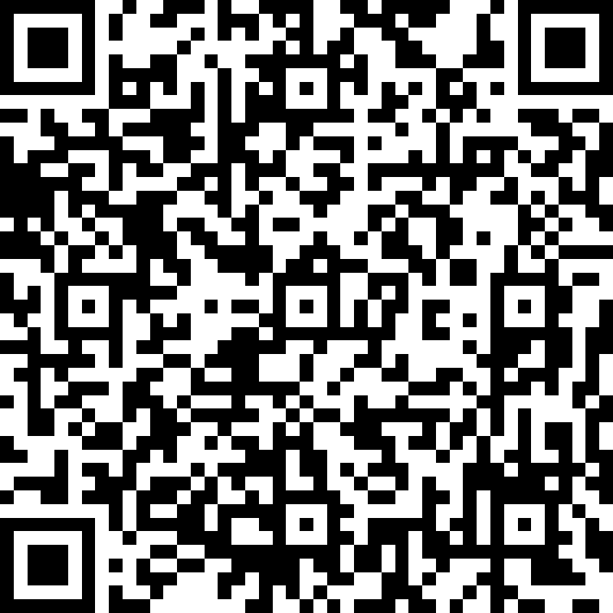
2018
QR Codes for Speaker Survey
Session #1

Slide 47
SharePoint 2019 – Dev Platform
Yes
No
Modern pages
Modern sites – Modern team and communication site
SharePoint Framework Extensions
Webhooks
Asset packaging (no CDN)
Column formatting
(Tenant scoped deployment)
(ALM APIs)
Site Designs
Hub sites
Site collection app catalog
“Tenant” properties
View Formatting
Preliminary plan, subject to change
SharePoint 2019 SharePoint Framework 3rd party version will be 1.4

